Slide 1
CSDS 451: Designing High Performant Systems for AI
Lecture 7
9/16/2025
Sanmukh Kuppannagari
sanmukh.kuppannagari@case.edu
https://sanmukh.research.st/
Case Western Reserve University

Slide 2
Outline
Parallel Program Analysis (Quick Review)
Data Parallel Algorithms
Sorting
Task Parallelism

Slide 3
Outline
Parallel Program Analysis (Quick Review)
Data Parallel Algorithms
Sorting
Task Parallelism

Slide 4
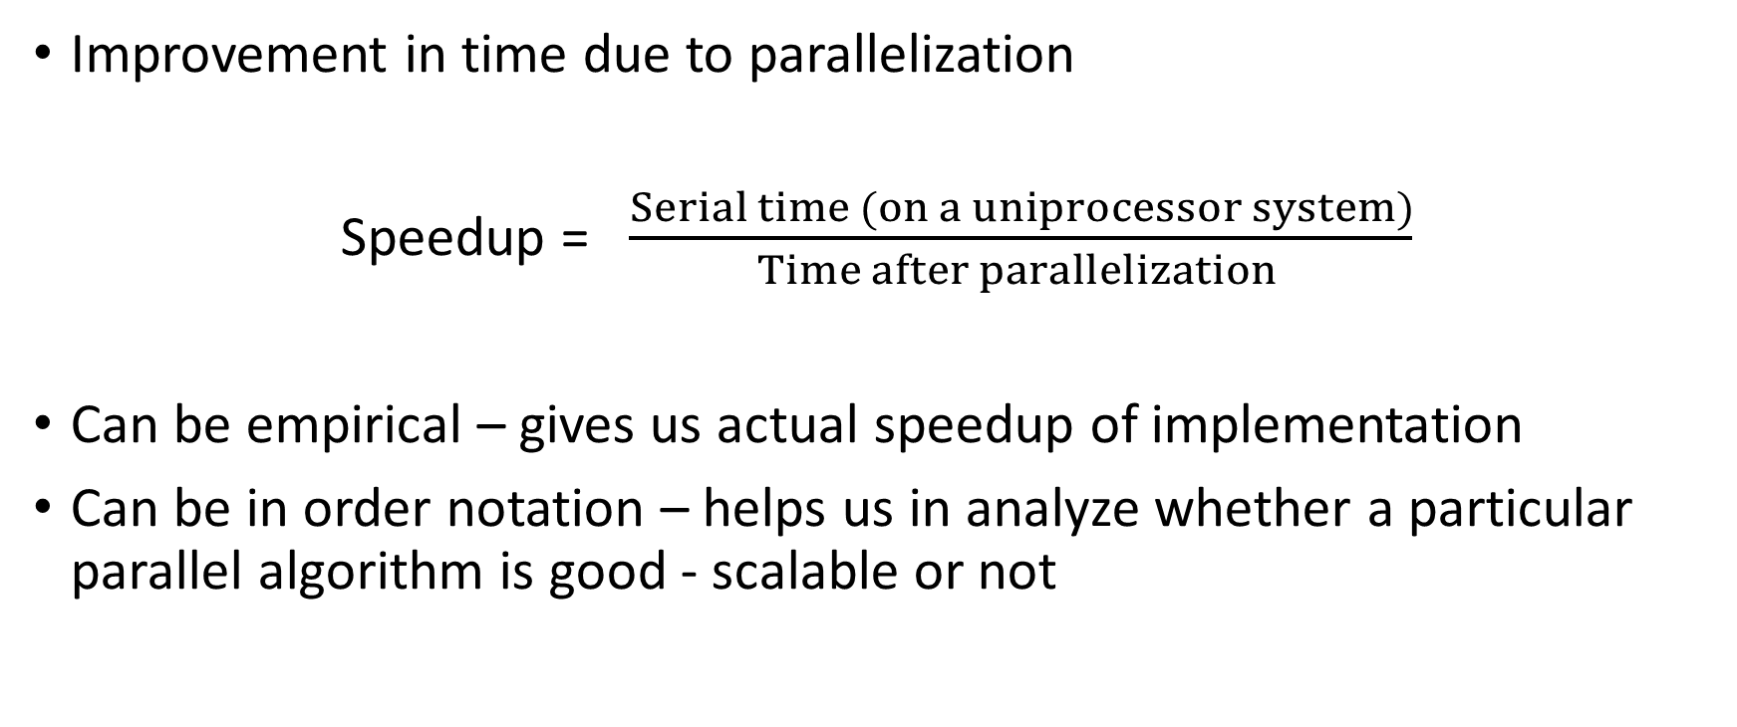
Speedup
Improvement in time due to parallelization
Speedup = $\frac{Serial time (on a uniprocessor system)}{Time after parallelization }$
Can be empirical – gives us actual speedup of implementation
Can be in order notation – helps us in analyze whether a particular parallel algorithm is good - scalable or not

Slide 5
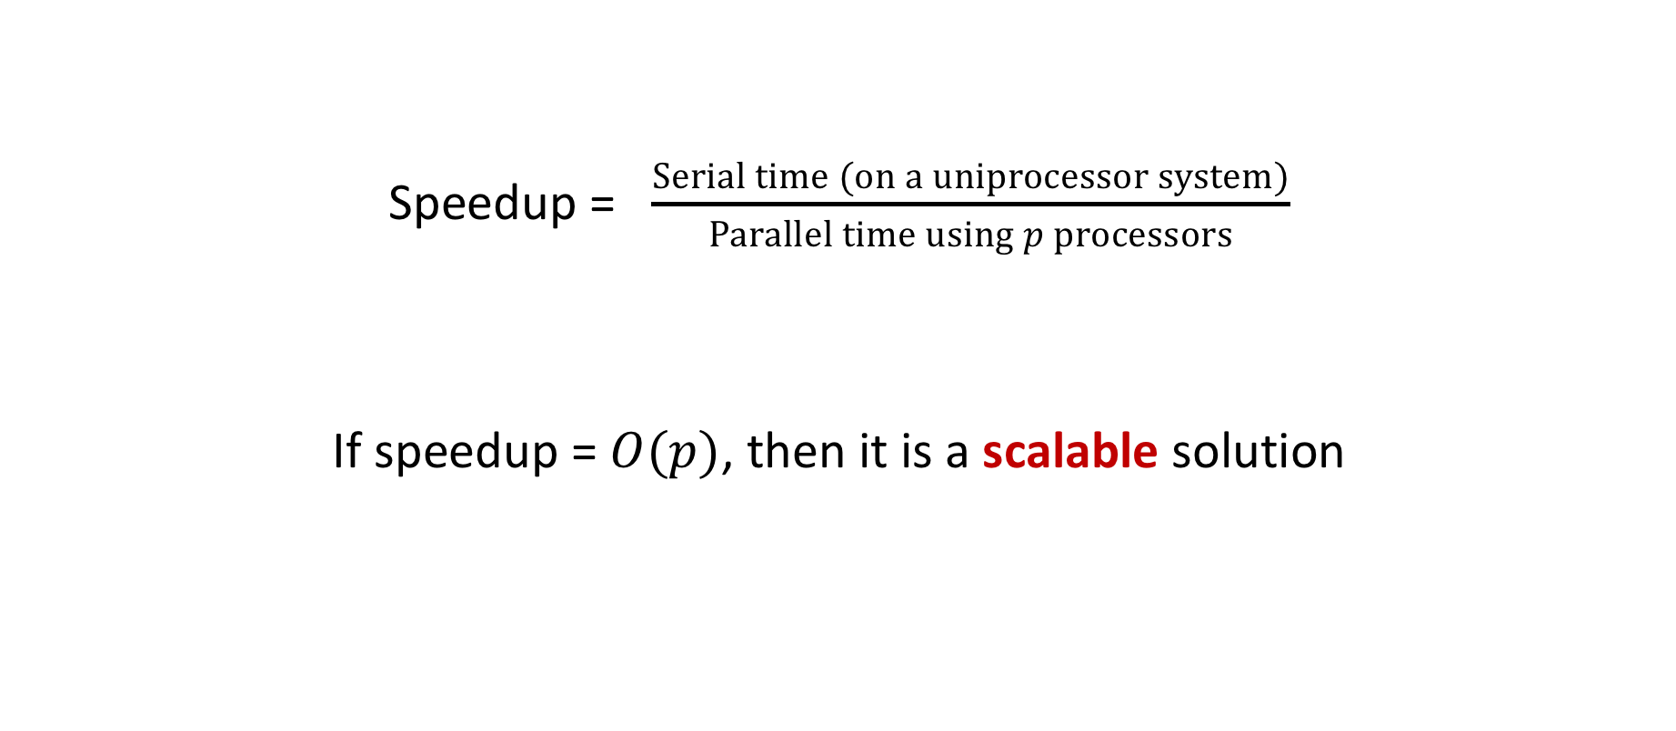
Scalability
Speedup = $\frac{Serial time (on a uniprocessor system)}{Parallel time using p processors}$
If speedup = $O(p)$, then it is a scalable solution

Slide 6





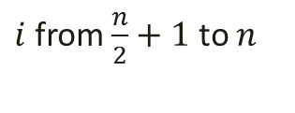
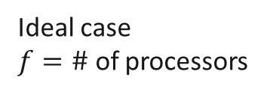
Amdahl’s Law
$$1$$
$$1$$
$$→\frac{1}{S}$$
Overall Speedup =
=
$$S+P/f$$
$$S+(1−S)/f$$
Ideal Overall
Speedup
Ideal case
$f=\#$ of processors
Number of Processors ($p$)

Slide 7
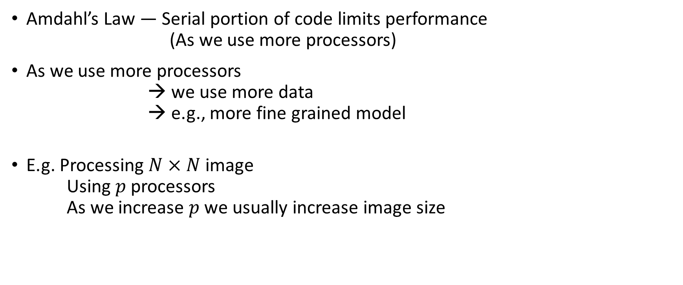
Scaled Speedup (Gustafson’s Law) (1)
Amdahl’s Law — Serial portion of code limits performance
(As we use more processors)
As we use more processors
we use more data
→ e.g., more fine grained model
E.g. Processing $N×N$image
Using $p$ processors
As we increase $p$we usually increase image size

Slide 8

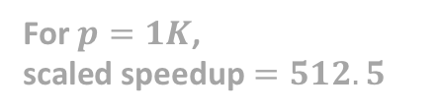
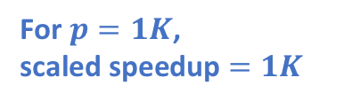
Scaled Speedup (Gustafson’s Law) (2)
For $p=1K$,
scaled speedup $=1K$
1024
Scaled
Speedup
512.5
For $p=1K$,
scaled speedup $=512.5$
Number of Processors ($p$)

Slide 9
Strong or Weak Scaling
Strong Scaling
Governed by Amdahl’s Law
The number of processors is increased while the problem size remains constant
Results in a reduced workload per processor
Weak Scaling
Governed by Gustafson’s Law
Both the number of processors and the problem size are increased
Results in a constant workload per processor
Notes:
https://hpc-wiki.info/hpc/Scaling_tests

Slide 10






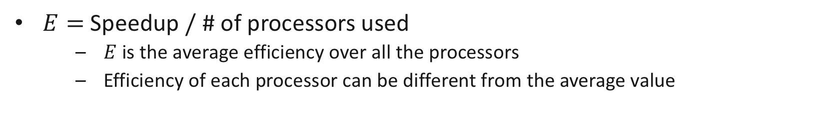
Performance (1)
Efficiency
Question: If we use $p$processors, is speedup = $p$?
Efficiency$=$Fraction of time a processor is usefully employed during the computation
Typical execution of a program on
a parallel machine
Serial time
$p$=1
Serial Computation
$$P_{1}$$
$p$=2
$$P_{2}$$
0.5
1
Time
useful work
$E=$Speedup$/$ # of processors used
$E$is the average efficiency over all the processors
Efficiency of each processor can be different from the average value
idle (overhead)

Slide 11
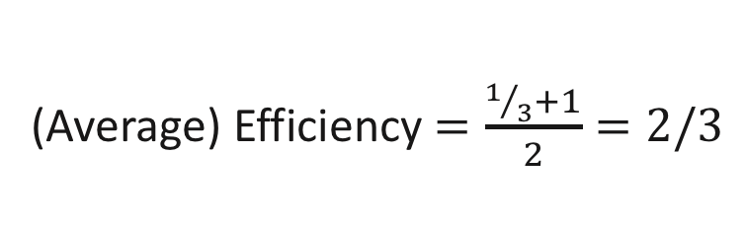
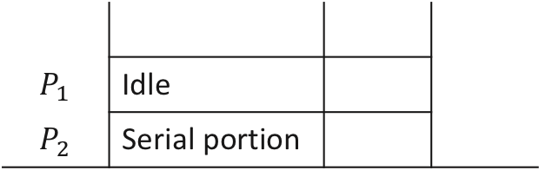
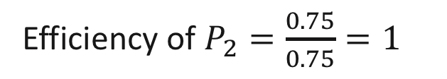

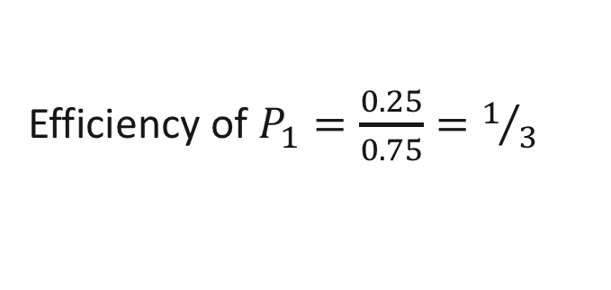
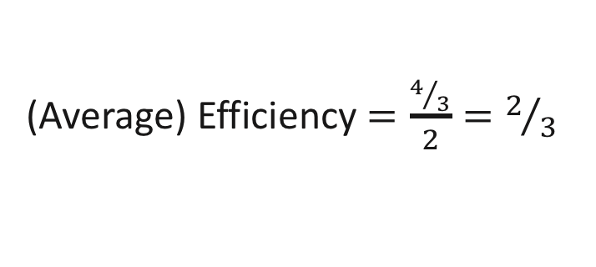
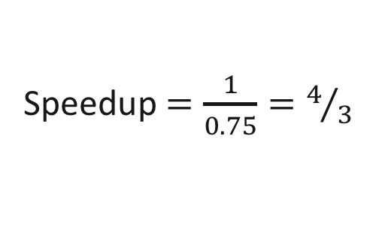
Performance (2)
$$S=0.5$$
$$P=0.5$$
Ex.
2 processor system
Speedup $=\frac{1}{0.75}=4/3$
Parallelized portion
(Ideal case)
(Average) Efficiency $=\frac{4/3}{2}=2/3$
$$P_{1}$$ | Idle
$$P_{2}$$ | Serial portion
Efficiency of $P_{1}=\frac{0.25}{0.75}=1/3$
Efficiency of $P_{2}=\frac{0.75}{0.75}=1$
0.5
0.75
time
(Average) Efficiency $=\frac{1/3+1}{2}=2/3$

Slide 12
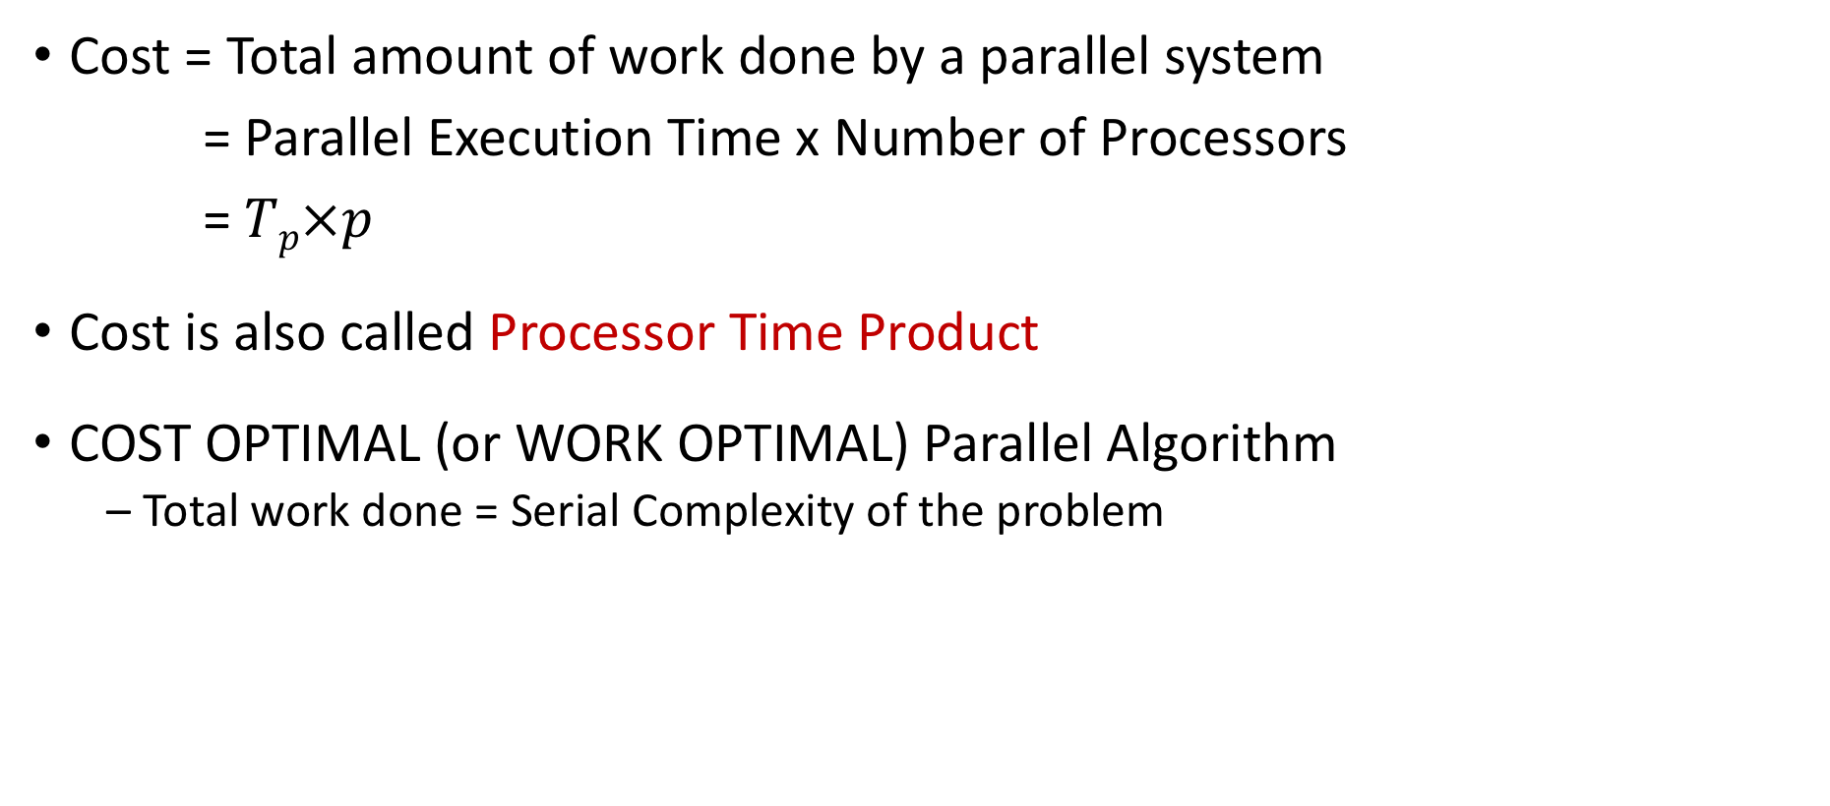
Performance (3)
Cost = Total amount of work done by a parallel system
= Parallel Execution Time x Number of Processors
= $Tp×p$
Cost is also called Processor Time Product
COST OPTIMAL (or WORK OPTIMAL) Parallel Algorithm
Total work done = Serial Complexity of the problem

Slide 13
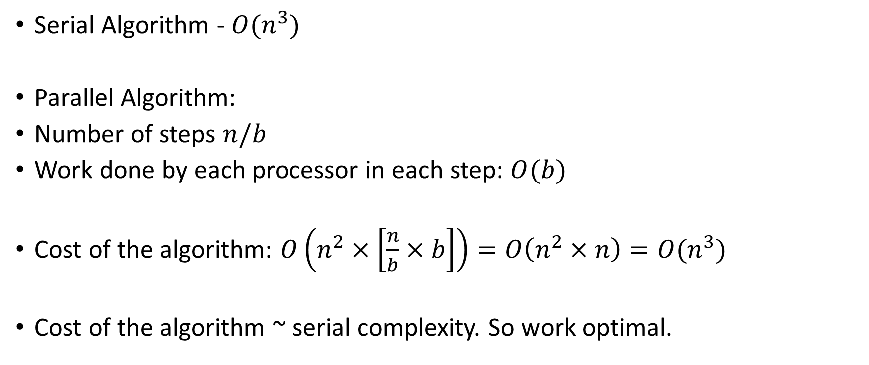
Blocked Matrix Multiplication
Serial Algorithm - $O(n^{3})$
Parallel Algorithm:
Number of steps $n/b$
Work done by each processor in each step: $O(b)$
Cost of the algorithm: $O\left(n^{2}×\left[\frac{n}{b}×b\right]\right)=O\left(n^{2}×n\right)=O(n^{3})$
Cost of the algorithm ~ serial complexity. So work optimal.
Total Number of Processors
Work done in each processor

Slide 14
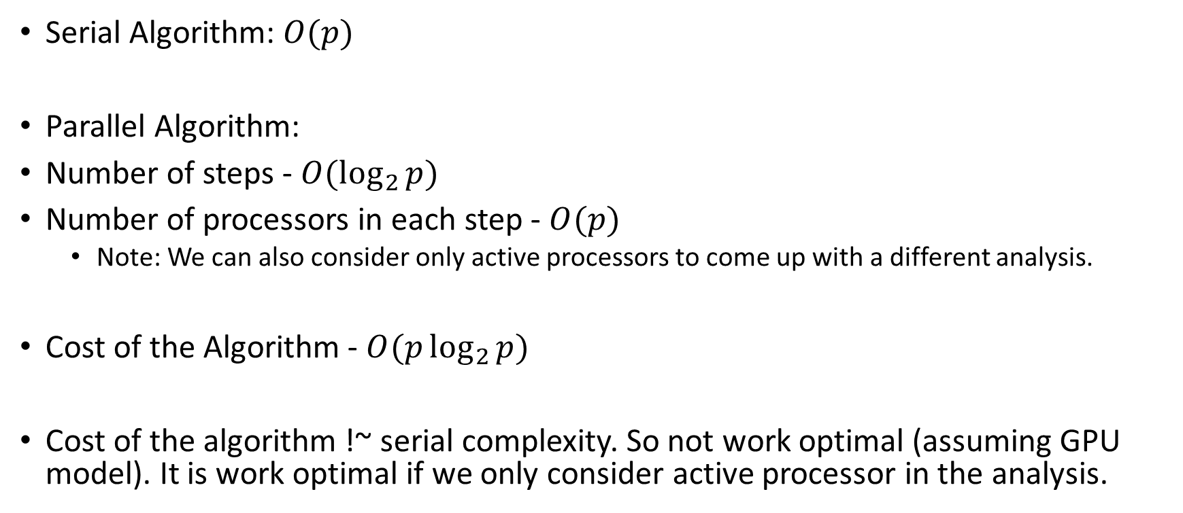
Sum of Elements in an Array
Serial Algorithm: $O(p)$
Parallel Algorithm:
Number of steps - $O(\log_{2}{p})$
Number of processors in each step - $O(p)$
Note: We can also consider only active processors to come up with a different analysis.
Cost of the Algorithm - $O(p\log_{2}{p})$
Cost of the algorithm !~ serial complexity. So not work optimal (assuming GPU model). It is work optimal if we only consider active processor in the analysis.

Slide 15
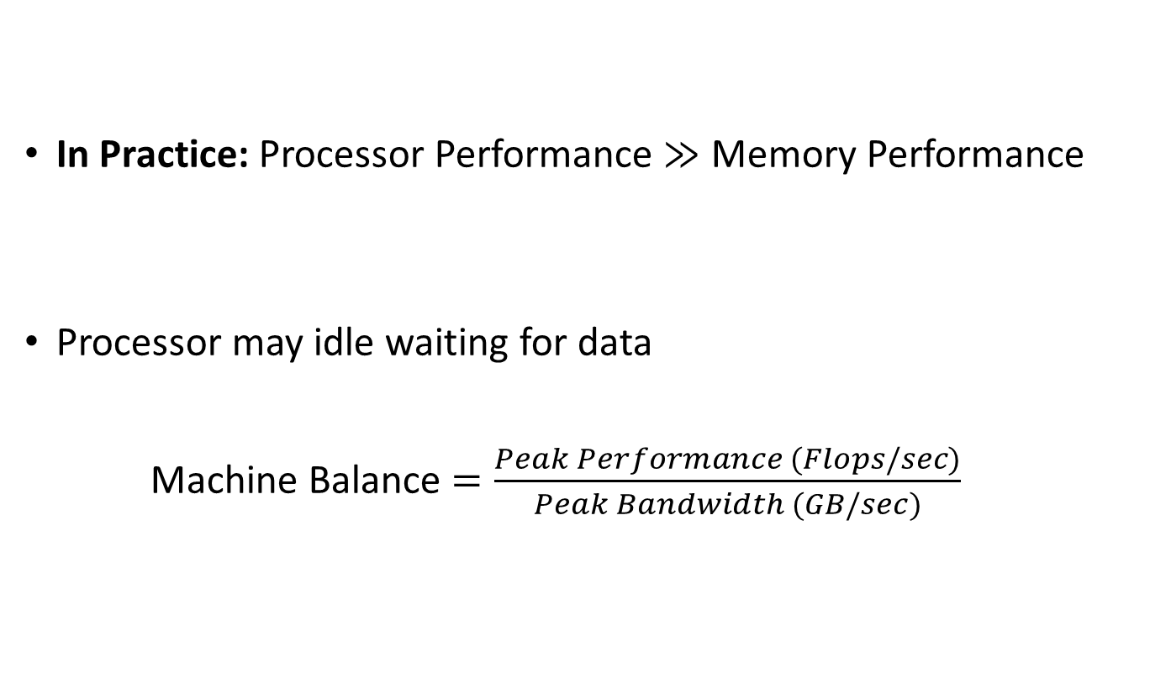
Roofline Model
In Practice: Processor Performance $≫$ Memory Performance
Processor may idle waiting for data
Machine Balance $=\frac{Peak Performance (Flops/sec)}{Peak Bandwidth (GB/sec)}$
M
# of data transferred/sec
Peak bandwidth
GB/sec
P
# of ops/sec
Peak Performance
# of floating point ops/sec
The Roofline Model
Samuel Williams, Lawrence Berkeley National Lab
https://escholarship.org/content/qt0qs3s709/qt0qs3s709.pdf

Slide 16
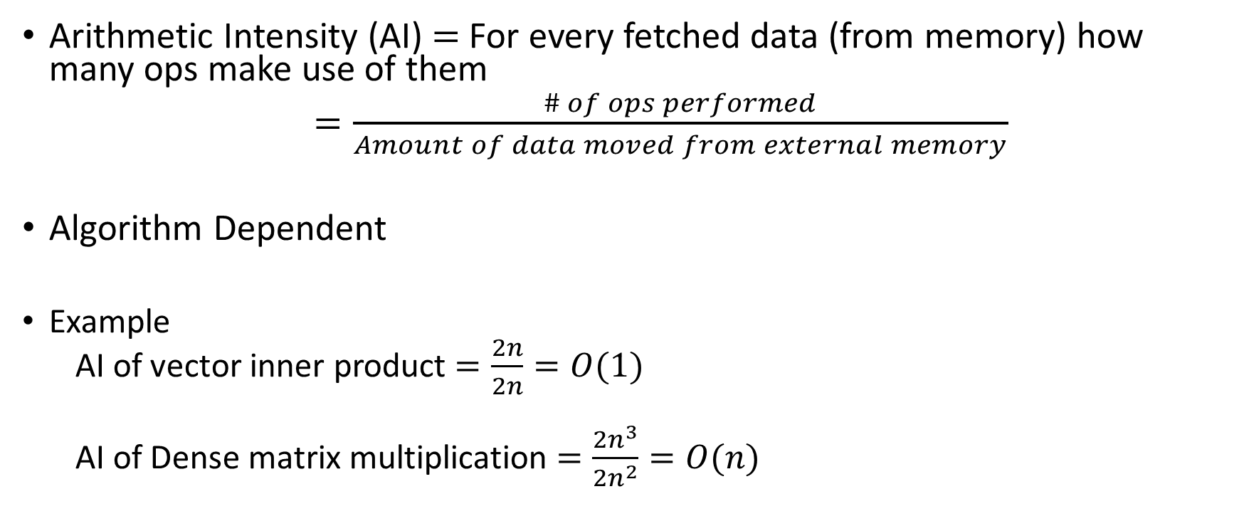
Roofline Model
Arithmetic Intensity (AI) $=$ For every fetched data (from memory) how many ops make use of them
$=\frac{\# of ops performed}{Amount of data moved from external memory}$
Algorithm Dependent
Example
AI of vector inner product $=\frac{2n}{2n}=O(1)$
AI of Dense matrix multiplication $=\frac{2n^{3}}{2n^{2}}=O(n)$

Slide 17
Roofline Model
Understand system bottlenecks – Computation vs Memory
High level model using few parameters (ignores ISA etc.)
Can be used to understand and evaluate an application performance on a target
Can be used to make architectural decisions for custom accelerators
The Roofline Model
Samuel Williams, Lawrence Berkeley National Lab
https://escholarship.org/content/qt0qs3s709/qt0qs3s709.pdf

Slide 18
Compute Bound vs Memory Bound Roofline Model (for a given platform)
Machine
Balance
Memory Bound
Compute Bound
Peak
Performance
Sustained Performance
(ops/sec)
log-log plot
1
10
0.1
Arithmetic Intensity

Slide 19
Compute Bound vs Memory Bound Roofline Model (for a given platform)
Machine
Balance
Memory Bound
Compute Bound
Peak
Performance
Sustained Performance
(ops/sec)
log-log plot
1
10
0.1
Arithmetic Intensity
Bold Red line denotes the maximum achievable performance for a given arithmetic intensity
Memory bound region: maximum achievable performance bounded by memory bandwidth
Compute bound region: maximum achievable performance bounded by compute capability

Slide 20
Compute Bound vs Memory Bound Roofline Model (for a given platform)
Compute Bound: Maximum Performance is limited by available compute resources
if we add more compute resources, the performance may improve (for a given bandwidth)
Useful in designing accelerators. Not a focus of this class
Memory Bound: Maximum Performance is limited by memory bandwidth
Reorder computations to more efficiently utilize bandwidth
In other words, improve arithmetic intensity to move right on x axis, which also improves y axis

Slide 21
Roofline Model – What about actual performance?
Machine
Balance
Memory Bound
Compute Bound
Peak
Performance
Sustained Performance
(ops/sec)
log-log plot
1
10
0.1
Arithmetic Intensity
For a fixed AI: improving performance (going up) requires better parallelism – Data and Task Parallel Techniques
Once the Red bold line is reached
Green Region: Write better algorithm to improve arithmetic intensity
Yellow Region: No algorithmic solution, need to add more computation power

Slide 22
Outline
Parallel Program Analysis (Quick Review)
Data Parallel Algorithms
Sorting
Task Parallelism

Slide 23



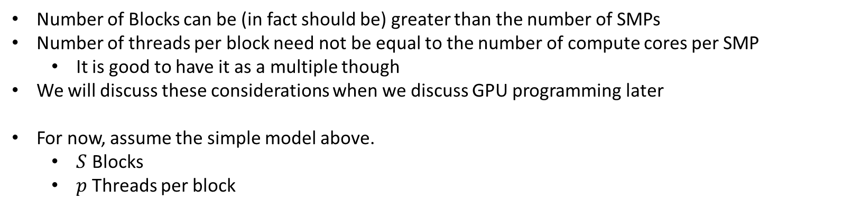



Modeling GPU Architectures
DRAM
$$0$$
$$1$$
$$S−1$$
C
C
C
0
1
$$p−1$$
0
1
$$p−1$$
0
1
$$p−1$$
Number of Blocks can be (in fact should be) greater than the number of SMPs
Number of threads per block need not be equal to the number of compute cores per SMP
It is good to have it as a multiple though
We will discuss these considerations when we discuss GPU programming later
For now, assume the simple model above.
$S$ Blocks
$p$ Threads per block

Slide 24

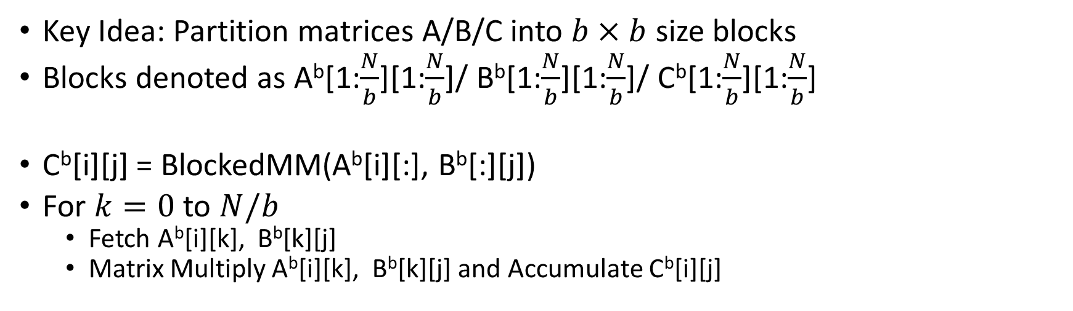


Block Matrix Multiplication
Key Idea: Partition matrices A/B/C into $b×b$ size blocks
Blocks denoted as A^{b}[1:$\frac{N}{b}$][1:$\frac{N}{b}$]/ B^{b}[1:$\frac{N}{b}$][1:$\frac{N}{b}$]/ C^{b}[1:$\frac{N}{b}$][1:$\frac{N}{b}$]
C^{b}[i][j] = BlockedMM(A^{b}[i][:], B^{b}[:][j])
For $k=0$ to $N/b$
Fetch A^{b}[i][k], B^{b}[k][j]
Matrix Multiply A^{b}[i][k], B^{b}[k][j] and Accumulate C^{b}[i][j]
$B^{b}[$:,j]
$A^{b}[$i,:]
$C^{b}[$i,j]

Slide 25



Block Matrix Multiplication
SMP: $BID_{i}, BID_{j}$
$B^{b}[$:,j]
Perform Matrix Multiplication of these two blocks
$A^{b}[$i,:]
$C^{b}[$i,j]

Slide 26
Block Matrix Multiplication
SMP: $BID_{i}, BID_{j}$
$B^{b}[$:,j]
Perform Matrix Multiplication of these two blocks
$A^{b}[$i,:]
$C^{b}[$i,j]

Slide 27
Block Matrix Multiplication
SMP: $BID_{i}, BID_{j}$
$B^{b}[$:,j]
Perform Matrix Multiplication of these two blocks
$A^{b}[$i,:]
$C^{b}[$i,j]

Slide 28
Block Matrix Multiplication
SMP: $BID_{i}, BID_{j}$
$B^{b}[$:,j]
Perform Matrix Multiplication of these two blocks
$A^{b}[$i,:]
$C^{b}[$i,j]

Slide 29


Block Matrix Multiplication
SMP: $0,0$
$$C$$

Slide 30

Block Matrix Multiplication
SMP: $0,1$
$$C$$

Slide 31

Block Matrix Multiplication
SMP: $0,2$
$$C$$

Slide 32

Block Matrix Multiplication
SMP: $0,3$
$$C$$

Slide 33

Block Matrix Multiplication
SMP: $?,?$
$$C$$

Slide 34
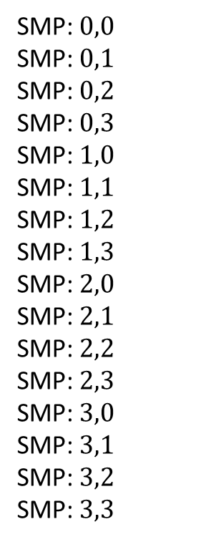
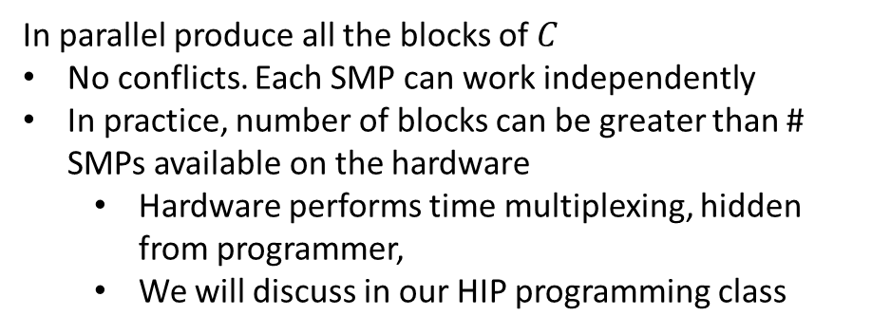
Block Matrix Multiplication
SMP: $0,0$
SMP: $0,1$
SMP: $0,2$
SMP: $0,3$
SMP: $1,0$
SMP: $1,1$
SMP: $1,2$
SMP: $1,3$
SMP: $2,0$
SMP: $2,1$
SMP: $2,2$
SMP: $2,3$
SMP: $3,0$
SMP: $3,1$
SMP: $3,2$
SMP: $3,3$
In parallel produce all the blocks of $C$
No conflicts. Each SMP can work independently
In practice, number of blocks can be greater than # SMPs available on the hardware
Hardware performs time multiplexing, hidden from programmer,
We will discuss in our HIP programming class
$$C$$

Slide 35












Sum of an Array
Block MM – Output Partitioning
Sum of an Array – Input Partitioning
Data Array
$$1$$
$$2$$
$$3$$
$$4$$
$$5$$
$$6$$
$$7$$
$$8$$
Processors
$$P_{1}$$
$$P_{3}$$
$$P_{5}$$
$$P_{7}$$

Slide 36




Sum of an Array
Block MM – Output Partitioning
Sum of an Array – Input Partitioning
Data Array
$$3$$
$$7$$
$$11$$
$$15$$
Processors
$$P_{3}$$
$$P_{7}$$

Slide 37
Sum of an Array
Block MM – Output Partitioning
Sum of an Array – Input Partitioning
Data Array
$$7$$
$$15$$
Processors
$$P_{7}$$

Slide 38
Parallel Sorting
Sort a list of elements in ascending (or descending) order
Input: [8,7,6,5,4,3,2,1]
Sorting Order: Ascending
Output: [1,2,3,4,5,6,7,8]

Slide 39
















Parallel Sorting
Input:
$$8$$
$$7$$
$$6$$
$$5$$
$$4$$
$$3$$
$$2$$
$$1$$
Output:
$$1$$
$$2$$
$$3$$
$$4$$
$$5$$
$$6$$
$$7$$
$$8$$
Can I do conflict-free output partitioning based data parallelism?

Slide 40
Parallel Sorting
Input:
$$8$$
$$7$$
$$6$$
$$5$$
$$4$$
$$3$$
$$2$$
$$1$$
Output:
$$1$$
$$2$$
$$3$$
$$4$$
$$5$$
$$6$$
$$7$$
$$8$$
Can I do conflict-free output partitioning based data parallelism? Maybe, for example if we do bucket or radix sort

Slide 41
Parallel Sorting
Input:
$$8$$
$$7$$
$$6$$
$$5$$
$$4$$
$$3$$
$$2$$
$$1$$
Output:
$$1$$
$$2$$
$$3$$
$$4$$
$$5$$
$$6$$
$$7$$
$$8$$
Can I do conflict-free output partitioning based data parallelism? Think about how that could work. (May include as a question in Exam)

Slide 42
Parallel Sorting
Input:
$$8$$
$$7$$
$$6$$
$$5$$
$$4$$
$$3$$
$$2$$
$$1$$
Output:
$$1$$
$$2$$
$$3$$
$$4$$
$$5$$
$$6$$
$$7$$
$$8$$
Can I do conflict-free output partitioning based data parallelism? We will discuss an input partitioning based approach in this lecture with a focus on comparison based sort

Slide 43
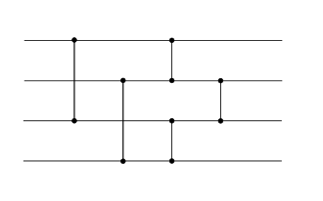
Parallel Sort
Definition: Sorting Networks
An abstraction built of a fixed number of “wires” that carry value, and comparators between pairs of “wires” that swap values if they are not in the desired order
https://en.wikipedia.org/wiki/Sorting_network

Slide 44
Parallel Sort
Definition: Sorting Networks
An abstraction built of a fixed number of “wires” that carry value, and comparators between pairs of “wires” that swap values if they are not in the desired order
0
1
4 wires = 4 values in the list
2
3
https://en.wikipedia.org/wiki/Sorting_network

Slide 45
Parallel Sort
Definition: Sorting Networks
An abstraction built of a fixed number of “wires” that carry value, and comparators between pairs of “wires” that swap values if they are not in the desired order
Temporal Order
0
1
4 wires = 4 values in the list
2
3
https://en.wikipedia.org/wiki/Sorting_network

Slide 46
Parallel Sort
Definition: Sorting Networks
An abstraction built of a fixed number of “wires” that carry value, and comparators between pairs of “wires” that swap values if they are not in the desired order
Swap 0 and 2 if not in order
0
1
4 wires = 4 values in the list
2
3
https://en.wikipedia.org/wiki/Sorting_network

Slide 47
Parallel Sort
Definition: Sorting Networks
An abstraction built of a fixed number of “wires” that carry value, and comparators between pairs of “wires” that swap values if they are not in the desired order
Swap 1 and 3 if not in order
0
1
4 wires = 4 values in the list
2
3
https://en.wikipedia.org/wiki/Sorting_network

Slide 48
Parallel Sort
Definition: Sorting Networks
An abstraction built of a fixed number of “wires” that carry value, and comparators between pairs of “wires” that swap values if they are not in the desired order
0
1
4 wires = 4 values in the list
Swap 0 and 1, 2 and3 if not in order (note: updated values used)
2
3
https://en.wikipedia.org/wiki/Sorting_network

Slide 49
Parallel Sort
Definition: Sorting Networks
An abstraction built of a fixed number of “wires” that carry value, and comparators between pairs of “wires” that swap values if they are not in the desired order
0
1
4 wires = 4 values in the list
Swap 2 and 3 if not in order (note: again updated values used)
2
3
https://en.wikipedia.org/wiki/Sorting_network

Slide 50
Parallel Sorting
Key Idea: Build a sorting network to visualize the computations
Use the visualization to understand parallelism and design a parallel program
A number of sorting algorithms exist: bitonic sort, odd-even sort, ….
Bitton, Dina, et al. "A taxonomy of parallel sorting." ACM Computing Surveys (CSUR) 16.3 (1984): 287-318.
Singh, Dhirendra Pratap, Ishan Joshi, and Jaytrilok Choudhary. "Survey of GPU based sorting algorithms." International Journal of Parallel Programming 46.6 (2018): 1017-1034.

Slide 51
Parallel Sorting
We will discuss Odd-Even Sort
Source: https://developer.nvidia.com/gpugems/gpugems2/part-vi-simulation-and-numerical-algorithms/chapter-46-improved-gpu-sorting
(Note the page uses an old GPU programming model)

Slide 52
Parallel Sorting
Odd-Even Sort – Similar to bubble sort,
In each iteration, move small keys upwards (and large key downwards) iteratively
Two types of iterations
Odd: Compare pairs starting at odd index – (1,2); (3,4); (5,6)
Even: Compare pairs starting at even index – (0,1); (2,3); (4,5)

Slide 53
Parallel Sorting
Odd-Even Sort – Similar to bubble sort,
In each iteration, move small keys upwards (and large key downwards) iteratively
Input Array
80
??
70
??
60
??
50
??
40
??
30
??
20
??
10
??
Iteration 1
(even)

Slide 54
Parallel Sorting
Odd-Even Sort – Similar to bubble sort,
In each iteration, move small keys upwards (and large key downwards) iteratively
Input Array
80
70
70
80
60
50
50
60
40
30
30
40
20
10
10
20
Iteration 1
(even)

Slide 55
Parallel Sorting
Odd-Even Sort – Similar to bubble sort,
In each iteration, move small keys upwards (and large key downwards) iteratively
Input Array
80
70
??
70
80
??
60
50
??
50
60
??
40
30
??
30
40
??
20
10
??
10
20
??
Iteration 2
(odd)

Slide 56
Parallel Sorting
Odd-Even Sort – Similar to bubble sort,
In each iteration, move small keys upwards (and large key downwards) iteratively
Input Array
80
70
70
70
80
50
60
50
80
50
60
30
40
30
60
30
40
10
20
10
40
10
20
20
Iteration 2
(odd)

Slide 57
Parallel Sorting
Odd-Even Sort – Similar to bubble sort,
In each iteration, move small keys upwards (and large key downwards) iteratively
Input Array
80
70
70
70
80
50
60
50
80
50
60
30
…
40
30
60
30
40
10
20
10
40
10
20
20
Iteration 3
(even)

Slide 58
Parallel Sorting
Odd-Even Sort – Similar to bubble sort,
In each iteration, move small keys upwards (and large key downwards) iteratively
Input Array
80
70
70
70
80
50
60
50
80
50
60
30
…
40
30
60
30
40
10
20
10
40
10
20
20
Iteration 4
(odd)

Slide 59
Parallel Sorting
Odd-Even Sort – Similar to bubble sort,
In each iteration, move small keys upwards (and large key downwards) iteratively
Input Array
80
70
70
10
70
80
50
20
60
50
80
30
50
60
30
…
40
40
30
60
50
30
40
10
60
20
10
40
70
10
20
20
80
Iteration 8
(odd)
Ungraded HW Assignment: Can you simulate the steps of all 8 iterations

Slide 60
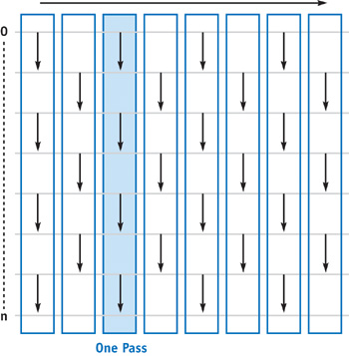
Parallel Sorting
Entire Sorting Network – Arrow can be used to represent the direction of comparison
https://developer.nvidia.com/gpugems/gpugems2/part-vi-simulation-and-numerical-algorithms/chapter-46-improved-gpu-sorting

Slide 61

Parallel Sorting
Odd-Even Sort
For an array of $n$ elements, terminates in at most $2n$ iterations
Serial Complexity: ??

Slide 62

Parallel Sorting
Odd-Even Sort
For an array of $n$ elements, terminates in at most $2n$ iterations
Serial Complexity: $O\left(n^{2}\right)$

Slide 63
Parallel Sorting
How do we parallelize?

Slide 64


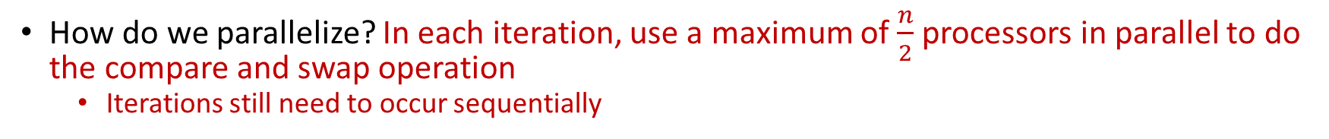

Parallel Sorting
How do we parallelize? In each iteration, use a maximum of $\frac{n}{2}$ processors in parallel to do the compare and swap operation
Iterations still need to occur sequentially
$$P_{1}$$
$$P_{2}$$
$$P_{3}$$
$$P_{4}$$

Slide 65


Parallel Sorting
How do we parallelize? In each iteration, use a maximum of $\frac{n}{2}$ processors in parallel to do the compare and swap operation
Iterations still need to occur sequentially
$$P_{1}$$
$$P_{2}$$
$$P_{3}$$

Slide 66



Parallel Sorting
How do we parallelize? In each iteration, use a maximum of $\frac{n}{2}$ processors in parallel to do the compare and swap operation
Iterations still need to occur sequentially
$$P_{1}$$
$$P_{2}$$
$$P_{3}$$
$$P_{4}$$

Slide 67


Parallel Sorting
How do we parallelize? In each iteration, use a maximum of $\frac{n}{2}$ processors in parallel to do the compare and swap operation
Iterations still need to occur sequentially
$$P_{1}$$
$$P_{2}$$
$$P_{3}$$

Slide 68



Parallel Sorting
How do we parallelize? In each iteration, use a maximum of $\frac{n}{2}$ processors in parallel to do the compare and swap operation
Iterations still need to occur sequentially
$$P_{1}$$
$$P_{2}$$
$$P_{3}$$
$$P_{4}$$

Slide 69


Parallel Sorting
How do we parallelize? In each iteration, use a maximum of $\frac{n}{2}$ processors in parallel to do the compare and swap operation
Iterations still need to occur sequentially
$$P_{1}$$
$$P_{2}$$
$$P_{3}$$

Slide 70



Parallel Sorting
How do we parallelize? In each iteration, use a maximum of $\frac{n}{2}$ processors in parallel to do the compare and swap operation
Iterations still need to occur sequentially
$$P_{1}$$
$$P_{2}$$
$$P_{3}$$
$$P_{4}$$

Slide 71


Parallel Sorting
How do we parallelize? In each iteration, use a maximum of $\frac{n}{2}$ processors in parallel to do the compare and swap operation
Iterations still need to occur sequentially
$$P_{1}$$
$$P_{2}$$
$$P_{3}$$

Slide 72
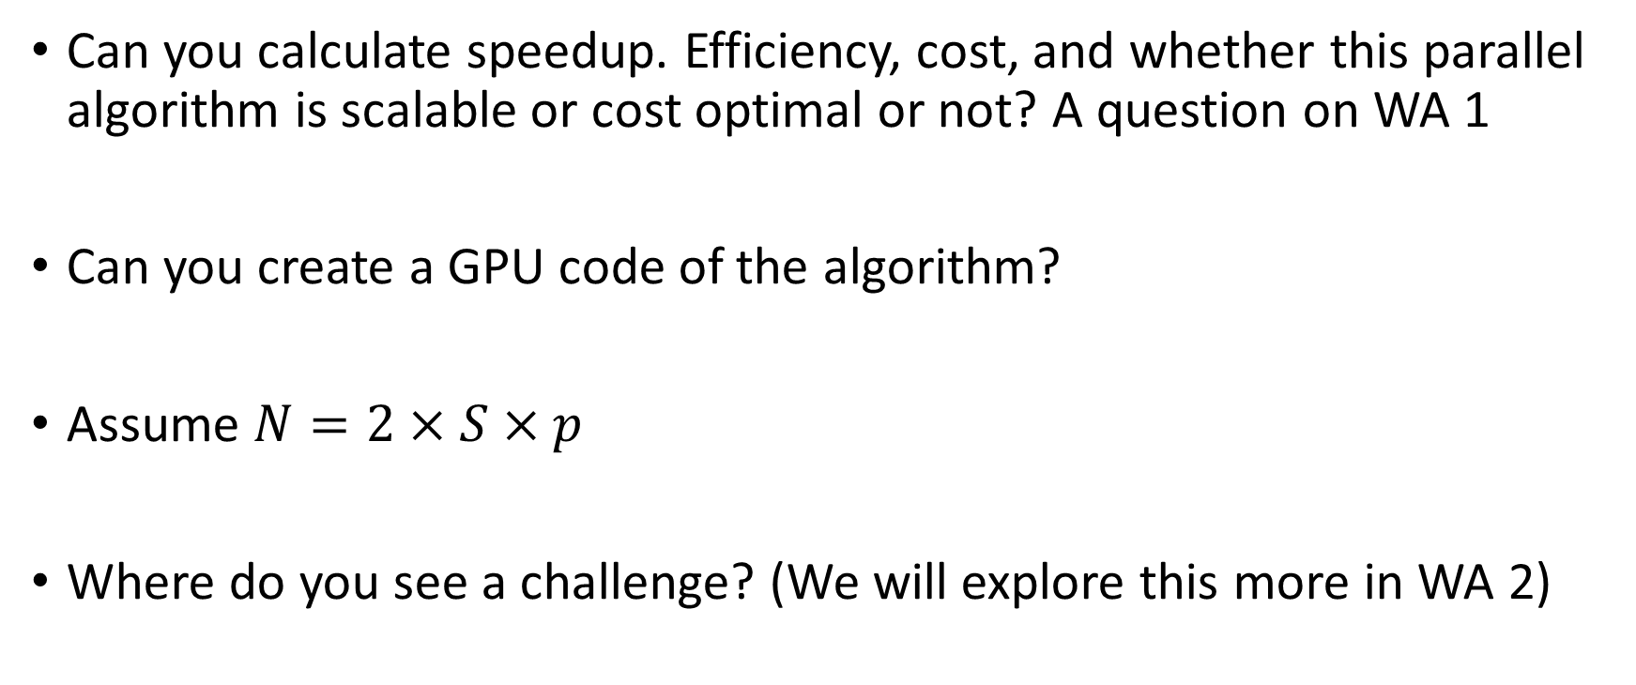
Parallel Sorting
Can you calculate speedup. Efficiency, cost, and whether this parallel algorithm is scalable or cost optimal or not? A question on WA 1
Can you create a GPU code of the algorithm?
Assume $N=2×S×p$
Where do you see a challenge? (We will explore this more in WA 2)

Slide 73
Parallel Sorting
Even for comparison based sort, algorithms with better cost/work exist
Check out these papers:
Bitton, Dina, et al. "A taxonomy of parallel sorting." ACM Computing Surveys (CSUR) 16.3 (1984): 287-318.
Singh, Dhirendra Pratap, Ishan Joshi, and Jaytrilok Choudhary. "Survey of GPU based sorting algorithms." International Journal of Parallel Programming 46.6 (2018): 1017-1034.
You are not expected to know these algorithms for exams
But I may give you an algorithm and ask you to do analysis or convert into a GPU code.

Slide 74
Outline
Parallel Program Analysis (Quick Review)
Data Parallel Algorithms
Sorting
Task Parallelism

Slide 75
Writing Parallel Programs
Key Idea: Need to decompose an algorithm into chunks of independent tasks.
Such that it can get best performance
Two approaches
Data Parallelism (SPMD): decompose algorithm into tasks that perform “same” work on different data
Task Parallelism: decompose algorithm into tasks that perform “different” work

Slide 76





Task vs Data Parallelism
Consider Matrix Vector Multiplication
Row 0
$$P_{0}$$
Row i
Row 1
$$P_{1}$$
$$P_{0}$$
Row $m−1$
$$P_{1}$$
Note: Data Parallelism is a special case of task parallelism
Data Parallelism
Task Parallelism

Slide 77
Task Parallelism Techniques
How to write parallel program using task parallelism paradigm?
Can be tricky, needs careful analysis of tasks (operations to be performed) and their dependencies
Careful selection of the granularity of tasks
Lowest granularity – operation level (e.g., Task parallel MV)
Coarser granularity – example, matrix row level in MV
Coarser granularity leads to reduced overheads, but may lose on opportunities of parallelism

Slide 78






Tasks and Dependencies
Computation = decompose into tasks
Task = Set of instructions (program segment)
Inputs & outputs
$$x_{1}$$
$$x_{2}$$
$$x_{3}$$
Begin execution once all inputs are available
$$w_{i}$$
$$y_{1}$$
$$y_{2}$$
Task size?
Fine grain
= weight of the node
(e.g., # of instructions executed)
Coarse grain
Note: tasks need not be of the same size

Slide 79

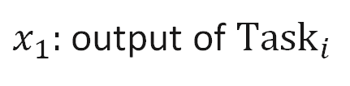






Task Dependency Graph
Directed Acyclic Graph
${Task}_{j}$ cannot start until ${Task}_{i}$ completes
$$w_{i}$$
$$i$$
Data
$x_{1}:$ output of ${Task}_{i}$
$$x_{1}$$
Input to ${Task}_{j}$
$$w_{j}$$
$$j$$
Weight of a node: task size
Task dependency graph need not be connected
Graph is acyclic

Slide 80











Task Dependency Graph
$$w_{i}$$
$$i$$
$$i$$
$$i$$
$$w_{i}$$
$$w[ij]$$
$$x_{1}$$
$$x_{1}$$
$$x_{1}$$
$$j$$
$$w_{j}$$
$$j$$
$$w_{j}$$
$$j$$

Slide 81
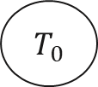
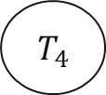
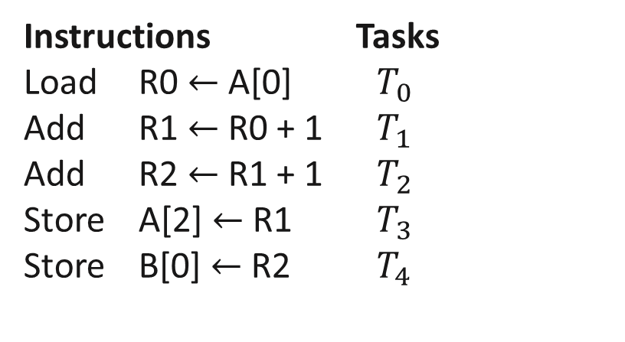
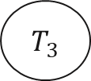
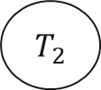

Example (1)
Code
A[2] = A[0] + 1
B[0] = A[2] + 1
Task Dependency Graph
$${ T}_{0}$$
$${ T}_{1}$$
Instructions Tasks
Load R0 $←$ A[0] $T_{0}$
Add R1 $←$ R0 + 1 $T_{1}$
Add R2 $←$ R1 + 1 $T_{2}$
Store A[2] $←$ R1 $T_{3}$
Store B[0] $←$ R2 $T_{4}$
$${ T}_{3}$$
$${ T}_{2}$$
$${ T}_{4}$$

Slide 82



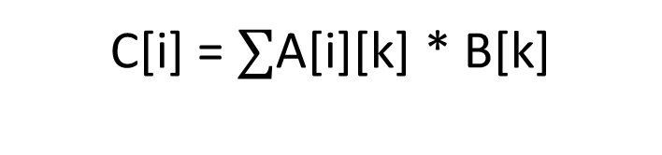
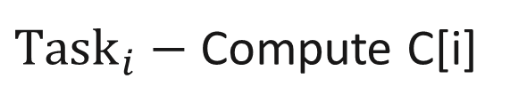
Example (2)
Matrix Vector Multiplication
C[i] = $∑$A[i][k] * B[k]
${Task}_{i}−$ Compute C[i]
$$n×n$$
Parallel for i = 1 to n
$$T_{0}$$
$$T_{n−1}$$
Compute C[i]
…
End
Output C
Output C

Slide 83
Maximum Degree of Concurrency (1)
Given a task dependency graph,
maximum number of tasks that can be executed concurrently
Maximum Parallelism Achievable at any Point in the code -> Decide number of processors

Slide 84
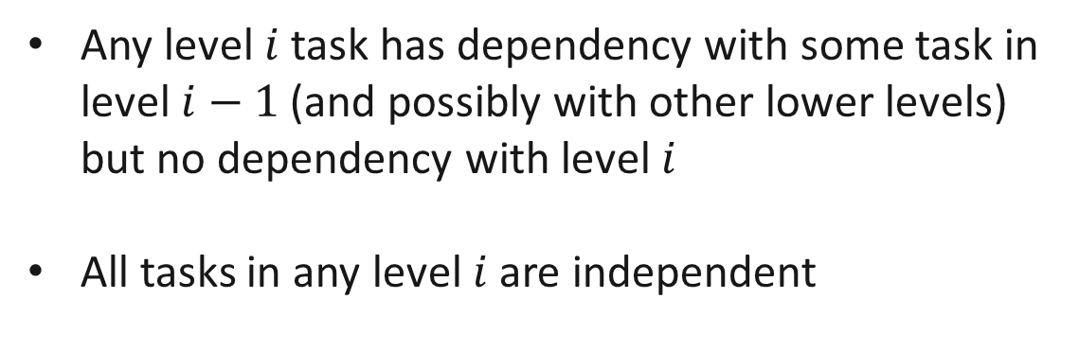
Maximum Degree of Concurrency (2)
Example: level by level ordering (topological sort)
Task dependency graph
Order tasks level by level
Any level $i$ task has dependency with some task in level $i−1$(and possibly with other lower levels) but no dependency with level $i$
All tasks in any level $i$ are independent
Execute level $i$ tasks (in parallel), and then level $i+1$ tasks

Slide 85
Maximum Degree of Concurrency (3)
Example: level by level ordering (cont.)
Find the number of tasks in each level
Take maximum over all levels = maximum degree of concurrency
(if scheduled using level by level ordering)

Slide 86
Maximum Degree of Concurrency (4)
Example
1
2
3
4
5
6
7
8
9
10

Slide 87
Maximum Degree of Concurrency (5)
Example (cont.)
Level 0
1
2
3
4
1
5
7
9
2
6
8
3
10
Maximum degree of concurrency = 4

Slide 88
Critical Path (1)
Dependency graph
Start nodes
(indeg = 0)
Finish nodes
(outdeg = 0)
Critical path =
A longest path from a start node to a finish node (# of edges)
Critical path length =
Sum of the task weights of the nodes along the critical path

Slide 89


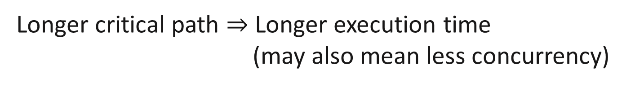

Critical Path (2)
Note: Critical path length considers critical path only (long paths)
$$1$$
$$1$$
$$1$$
For a given number of tasks,
Longer critical path $⇒$ Longer execution time
(may also mean less concurrency)

Slide 90
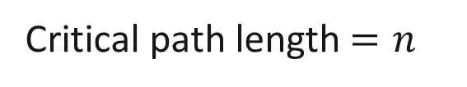





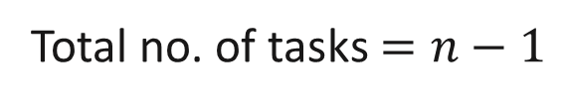
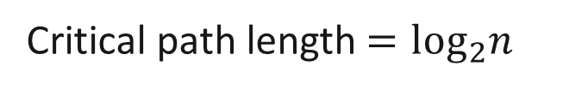

Critical Path (3)
$$T_{0}$$
$$n/2$$
$$n/4$$
…
…
…
…
$$T_{n−1}$$
$$1$$
Total no. of tasks $=n$
Total no. of tasks $=n−1$
Critical path length $=n$
Critical path length $=\log_{2}n$

Slide 91

Critical Path (4)
Task 4
Task 3
Task 2
Task 1
100
10
8
10
6
Task 5
11
Task 6
7
Task 7
Critical path length $=$10+6+11+7 $=$ 34

Slide 92

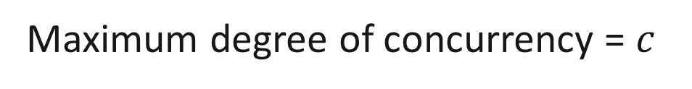
Task dependency graph to Parallel Program (1)
Given
a task dependency graph
Assume weight of each node = 1
Maximum degree of concurrency = $c$
Critical path length = $l$

Slide 93
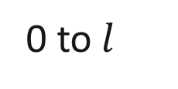


Task dependency graph to Parallel Program (2)
Idea
DAG
Organize into levels 0, 1, …, $l$ (level by level ordering)
$(l+1)$ levels
Execute level by level,
0 to$l$
Total number of processors needed $≤c$

Slide 94























Mapping Tasks to Processes
$$T_{1}$$
$$T_{2}$$
$$T_{3}$$
$$T_{4}$$
$$T_{1}$$
$$T_{2}$$
$$T_{3}$$
$$T_{4}$$
$$P_{3}$$
$$P_{2}$$
$$P_{1}$$
$$P_{0}$$
$$P_{3}$$
$$P_{2}$$
$$P_{1}$$
$$P_{0}$$
$$P_{0}$$
$$T_{5}$$
$$T_{5}$$
$$P_{2}$$
$$T_{6}$$
$$P_{0}$$
$$P_{0}$$
$$T_{6}$$
$$T_{7}$$
$$P_{0}$$
$$P_{0}$$
$$T_{7}$$

Slide 95
Next Class
9/18 Lecture 8 – Systolic Array Architecture – Modeling, Matrix Multiplication;

Slide 96
Thank You
Questions?
Email: sanmukh.kuppannagari@case.edu

